Slide 1

Welcome
NServiceBus v6 API
webinar
Notes:
A warm welcome to part II webinar in the async webinar series.
Today we talk about the task parallel library and message pumps

Slide 2

Solution Architect
Enthusiastic Software Engineer
Microsoft MVP for systems integration
@danielmarbach
particular.net/blog
planetgeek.ch
Notes:
I’m Daniel, Solution Architect…
I live in central Switzerland. If you want to know more about me listen to episode 77 of developer on fire
You can reach me on twitter under @danielmarbach
I blog on the particular blog and on my personal blog
Subscribe after this webinar

Slide 3


chocolate
factory
https://commons.wikimedia.org/wiki/File:Flag-map_of_Switzerland.svg
Notes:
Switzerland = excellent chocolate bars
International demand is raising
Chocolate manufacturers in Switzerland realized need for Highly reliable chocolate control and supervision system
Distributed architecture good fit manufacturing chocolate
Secret ingredients is Vanilla Federal Act on Foodstuffs and Utility Article 817 additives such as Vanilla need to be tracked
Vanilla as an additive became so popular that the government introduced a vanilla service to acquire vanilla
Someone argued that NSB good fit to introduce reliability,
others said Swiss Made is enough to indicate robust and reliable solutions.
After long arguments Swiss made enough for reliability but probably not for scalability
Built their first system on NSB

Slide 4

ChocolateBarProducer (Policy)
RoastBeans
Roasting
GrindBeans
ProduceChocolateBar
Grinding
Facility
BlendChocolate
Blending
Notes:
ChocolateBarProducer controls the chocolate manufacturing process started by ProduceChocolateBar
Roasting, were beans get smoothly roasted (BeansRoasted)
Grinding, were beans get ground and liquefied (BeansGround)
Blending, final step. During blending vanilla gets acquired, tracked and the bars get produced
ChocolateBlended finishes the workflow.

Slide 5

Demo
await
V5
Notes:
A short demo about the running system.

Slide 6

chocolate
as-a-service
Notes:
Totally underestimated the spiky demands during Christmas and Easter system
On-premise made it hard to elastically up and down scale (including customer facing frontends)
Platform as a Service seemed to be the answer
Wanted to use Paas offerings like Blobstorage, DocumentDB

Slide 7
class VanillaHandler : IHandleMessages<AcquireVanilla> {
void Handle(AcquireVanilla message)
{
AcquireVanillaFromGovernmentService();
StoreVanillaUsageInDatabase();
}
}
Notes:
Previously their handler looked really simple and straightforward like this handler above.
In the cloud environment that code drastically changed

Slide 8
class VanillaHandler : IHandleMessages<AcquireVanilla> {
void Handle(AcquireVanilla message)
{
AcquireVanillaFromGovernmentAsync().Result;
DownloadRecipeFromBlobStorageAsync().Wait();
InsertVanillaUsageInDocumentDBAsync().Result;
StoreTelemetryDataInEventHubAsync().Wait();
}
}
Notes:
The APIs they were using were mostly asynchronous
Started to get cumbersome
Someone from the team wanted to get rid of .Result and Wait calls
Too many drawbacks like original exception being masked inside AggregateException
Not leveraging true potential of async APIs because of the blocking calls they were using

Slide 9
class VanillaHandler : IHandleMessages<AcquireVanilla> {
void Handle(AcquireVanilla message)
{
await AcquireVanillaFromGovernmentServiceAsync();
await DownloadRecipeFromBlobStorageAsync();
await InsertVanillaUsageInDocumentDBAsync();
await StoreTelemetryDataInEventHubAsync();
}
}
Notes:
So they started rewriting their handlers to use CSharps async/await feature.
So instead of .Result and .Wait calls at the end they wrote the await keyword in front of their calls.
The problem of this code was

Slide 10
Error CS4033 The 'await' operator can only be used within an async method. Consider marking this method with the 'async' modifier and changing its return type to 'Task'.
Notes:
It didn’t compile.

Slide 11
ALT + ENTER
Notes:
Let’s Alt+ENTER all the things shall we?

Slide 12
class VanillaHandler : IHandleMessages<AcquireVanilla> {
async void Handle(AcquireVanilla message)
{
await AcquireVanillaFromGovernmentServiceAsync();
await DownloadRecipeFromBlobStorageAsync();
await InsertVanillaUsageInDocumentDBAsync();
await StoreTelemetryDataInEventHubAsync();
}
}
Notes:
Fixed. Build. Continous Integration, Continuous Deployement to the cloud, done. It’s beer’o clock lets go home
One day a really angry customer called in because their custom made chocolate bar order submitted 2 weeks ago never arrived
Project managers got angry, and the team committed to do everything they can to find out the root cause
Tracked it down to the above Handler
Weak element in the system. But why?

Slide 13



Void Handler
AcquireVanillaFromGovernmentServiceAsync().Result;
DownloadRecipeFromBlobStorageAsync().Wait();
InsertVanillaUsageInDocumentDBAsync().Result;
StoreTelemetryDataInEventHubAsync().Wait();
Notes:
With the traditional blocking version a message gets picked from the queue and is dispatched onto the handler.
The handler execution time is the sum of all blocking operations. When all operations are successful the message is marked as successfully processed and removed from the queue.
But what happens in an error scenario?

Slide 14
Void Handler
AcquireVanillaFromGovernmentServiceAsync().Result;
DownloadRecipeFromBlobStorageAsync().Wait();
InsertVanillaUsageInDocumentDBAsync().Result;
StoreTelemetryDataInEventHubAsync().Wait();
Notes:
When one of the API calls throws an exception, that exception gets wrapped into an AggregateException and propagated back to NServiceBus’ infrastructure.
The message is marked as NOT successfully processed and retried until successful or moved into the error queue.
But what happened with the async void variant?

Slide 15
Async void Handler
await AcquireVanillaFromGovernmentServiceAsync();
await DownloadRecipeFromBlobStorageAsync();
await InsertVanillaUsageInDocumentDBAsync();
await StoreTelemetryDataInEventHubAsync();
Notes:
The message gets dispatched to the handler.
NServiceBus infrastructure calls into the handler.
Everything which is executed synchronous can still be observed by NServiceBus.
As soon as the code enters the first await block (in fact the IO completion port) from the perspective of NServiceBus the handler call is over.
The message is marked successful and removed from the queue. This is not a big deal as long as none of these API calls throws an exception
but when one does…

Slide 16
Async void Handler
await AcquireVanillaFromGovernmentServiceAsync();
await DownloadRecipeFromBlobStorageAsync();
await InsertVanillaUsageInDocumentDBAsync();
await StoreTelemetryDataInEventHubAsync();
Notes:
Remember message is already marked successful as soon as we enter the first IO completion port.
Async void is a relict which was introduced for Windows Forms and WPF event handlers.
The semantics of those is Fire & Forget.
Exceptions raised by those calls are raised behind the scenes and cannot be observed by the caller of the event handler or in our case the message handler.
Mark my words: Async void is EVIL (with capital letters)

Slide 17

Engine
Version 5
Notes:
The analysis by the team showed that NServiceBus v5 is not built for asynchronous code.
It would technically be possible to intercept the exception raised behind the scenes but the true benefit of the asynchronous APIs could still not be used.

Slide 18

async
it’s time
particular.net/blog/async-await-its-time
Notes:
We saw it in the code written by the team. Microsoft and the community is moving all their APIs which are IO bound over to the async/await model. In fact Microsoft Windows 8 API Guidelines say that all IO API calls taking longer than 50 ms should be async. Async/await has mature and is widely adopted even outside the .NET distortion field.
the ECMAScript 7 specification process accepted the Async Functions specification. Dart will adopt it. Go already has it as Coroutines and Python will introduce it as well.
Even more important is the fact the NServiceBus’s core domain, queuing, persistence and even your code is mostly all about IO operations. To properly support async scenarios we had no choice but to rewrite NServiceBus to be entirely async from top to bottom. Let’s see how this looks like

Slide 19
class VanillaHandler : IHandleMessages<AcquireVanilla> {
Task Handle(AcquireVanilla message)
{
}
}
Notes:
The Handle method now returns a Task.

Slide 20
class VanillaHandler : IHandleMessages<AcquireVanilla> {
async Task Handle(AcquireVanilla message)
{
await AcquireVanillaFromGovernmentServiceAsync();
}
}
Notes:
This allows you to await asynchronous APIs by marking the method as async.

Slide 21
class VanillaHandler : IHandleMessages<AcquireVanilla> {
async Task Handle(AcquireVanilla message)
{
await AcquireVanillaFromGovernmentServiceAsync();
await DownloadRecipeFromBlobStorageAsync();
await InsertVanillaUsageInDocumentDBAsync();
await StoreTelemetryDataInEventHubAsync();
}
}
Notes:
And finally you can await all operations in your handler.
The biggest strength of this API change becomes apparent when you look at the composability the async APIs allow.
For example let’s assume each of the operations above take 5 seconds.
The total execution time of this handler would be 20 seconds when you await each call sequentially.
But you don’t have to.

Slide 22
class VanillaHandler : IHandleMessages<AcquireVanilla> {
Task Handle(AcquireVanilla message)
{
var t1 = AcquireVanillaFromGovernmentServiceAsync();
var t2 = DownloadRecipeFromBlobStorageAsync();
var t3 = InsertVanillaUsageInDocumentDBAsync();
var t4 = StoreTelemetryDataInEventHubAsync();
return Task.WhenAll(t1, t2, t3, t4);
}
}
Notes:
We can now decide to collect the tasks returned by the async API and instead of executing them sequentially we can execute them concurrently and await the success or failure of all of them. Essentially cutting down the handler execution time to approximately 5 seconds.

Slide 23
Async Task Handler
await AcquireVanillaFromGovernmentServiceAsync();
await DownloadRecipeFromBlobStorageAsync();
await InsertVanillaUsageInDocumentDBAsync();
await StoreTelemetryDataInEventHubAsync();
Notes:
The compiler and the .NET runtime take care that the underlying statemachine intercepts any exceptions raised by an async API and wraps that exception into the task object. Because we await those tasks the original exception gets raised and not an aggregate exception.

Slide 24
But there are not only asynchronous handlers
Notes:
But of course the team didn’t only have handlers which were asynchronous. How well does this API play with synchronous code? Pretty well!

Slide 25
class AnotherHandler : IHandleMessages<AnotherMessage> {
Task Handle(AnotherMessage message)
{
DoSomethingSynchronous();
}
}
Notes:
At first step we just write our synchronous code in the new handler API. This won’t compile.

Slide 26
class AnotherHandler : IHandleMessages<AnotherMessage> {
async Task Handle(AnotherMessage message)
{
DoSomethingSynchronous();
}
}
Notes:
The first option we have is to add the async keyword. Async Task is essentially the new void in the asynchronous world.

Slide 27
Warning CS1998 This async method lacks 'await' operators and will run synchronously. Consider using the 'await' operator to await non-blocking API calls, or 'await Task.Run(...)' to do CPU-bound work on a background thread.
Notes:
The side effects of this are that we get a compiler warning because we are not awaiting anything inside the handler. Suppressing this warning could be dangerous since we’d potentially miss a bug in another code. So the better option is

Slide 28
class AnotherHandler : IHandleMessages<AnotherMessage> {
Task Handle(AnotherMessage message)
{
DoSomethingSynchronous();
return Task.CompletedTask; // for .NET 4.6 return Task.FromResult(0); // for .NET 4.5
}
}
Notes:
Return Task.CompletedTask for .NET 4.6. For earlier .NET Versions you can use Task.FromResult(0);

Slide 29

Ambient
state
Notes:
Before you move over to v6 you need to check your code base for hidden ambient state. Ambient state is state which is accessed behind the scenes and not directly exposed as a first class citizen on your APIs. An example of ambient state is the usage of ThreadStatic or ThreadLocal.
If you want to know more about the Dangers of ThreadLocal read my recently published blogpost.

Slide 30
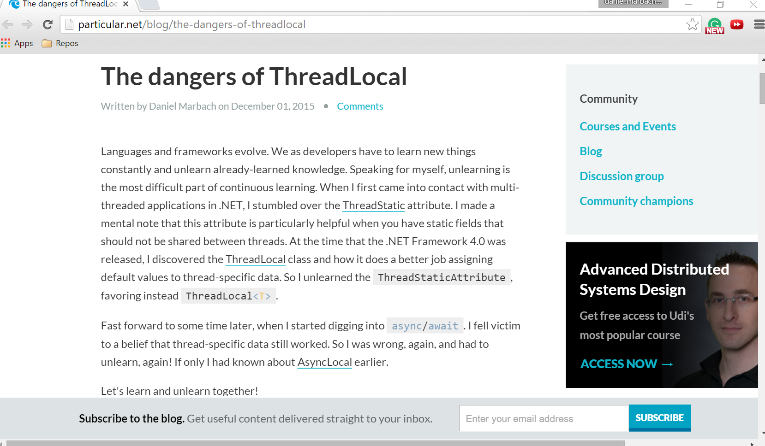

Slide 31
Ambient
state
Notes:
Also watch out if you are using Inversion of Control Container magic like PerThread Scope. Make sure to change it to container scoped. Or even better redesign your APIs to float state explicitely around in your code. I’ll cover this also in a series of blog posts.
Part of the async work we had to stop using the container and move to more explicit APIs.
Part of async we needed to stop using the container…

Slide 32

Context
floating state
www.insideevs.com
Notes:
That why we are providing you the bus…
Bus operations available on the context passed into the Handle method
No more: Where is the bus? Just declare a property…
More focused API and better distinction between outside and inside a handler
Future proof extension point we build upon, simpler to test
If you wanna know more, approach me in the hallways.

Slide 33
class VanillaHandler : IHandleMessages<AcquireVanilla> {
async Task Handle(AcquireVanilla message, IMessageHandlerContext context)
{
var vanilla = await webService.AcquireVanilla(message.LotNumber);
await context.Publish(new VanillaAcquired());
}
}
Notes:
Expert trick: If you just have one single async operation in your handler just use return.

Slide 34
Demo
await
V6
APIs are in early preview
Notes:
A short demo about the running system.

Slide 35

Guidance
docs.particular.net
Notes:
We’ve just seen in this live coding demo that the migration for synchronous and asynchronous code is straigt forward. Large portions of the migration process can be automated with code helpers and templates. Make sure you consider our upgrade guide on the docs site. Of course if you really want to embrace the full potential of async/await your code should change as well, but as shown before, doesn’t have to.

Slide 36

Engine
Version 6
www.hdwallbackgrounds.com
Notes:
Technology and frameworks evolve. Like we went from Gas to Hybrid with Cars. This is a natural progression. The new engine behind NSB 6 is built for asynchronous code and makes your code faster and more composable.
Transport is now the driver and Core in the backseat
It is the transports responsibility to either asynchronously or concurrently push messages into Core
We are asynchronous all the way down

Slide 37
Slides, Links…
github.com/danielmarbach/03-10-2016-AsyncWebinar
Notes:
Questions that can be answered in blog posts

Slide 38
Q & A
await
Notes:
Q & A

Slide 39
Thanks
Notes:
Thank you very much for listening and see you next time

